Slide 1

Amazon CloudFront

Slide 2
Module Objectives
You should able to answer below questions end of this module.
Describe Content Delivery Network and pros & cons
Describe Amazon Content Delivery Network Solution.

Slide 3



Content delivery and network latency
Hop
Router
Hop
Hop
Origin server
Hop
Router
Router
Hop
Hop
Client
Router
Hop
User
Notes:
As explained earlier in this module when you were learning about AWS Direct Connect, one of the challenges of network communication is network performance. When you browse a website or stream a video, your request is routed through many different networks to reach an origin server. The origin server (or origin) stores the original, definitive versions of the objects (webpages, images, and media files). The number of network hops and the distance that the request must travel significantly affect the performance and responsiveness of the website. Further, network latency is different in various geographic locations. For these reasons, a content delivery network might be the solution.

Slide 4
Content delivery network (CDN)
A content delivery network, or content distribution network, is a geographically distributed network of proxy servers and their data centers. The goal is to provide high availability and performance by distributing the service spatially relative to end users
It is a globally distributed system of caching servers
Caches copies of commonly requested files (static content)
Delivers a local copy of the requested content from a nearby cache edge or Point of Presence
Accelerates delivery of dynamic contents
Improves application performance and scaling
Notes:
A content delivery network (CDN) is a globally distributed system of caching servers. A CDN caches copies of commonly requested files (static content, such as Hypertext Markup Language, or HTML; Cascading Style Sheets, or CSS; JavaScript; and image files) that are hosted on the application origin server. The CDN delivers a local copy of the requested content from a cache edge or Point of Presence that provides the fastest delivery to the requester.
CDNs also deliver dynamic content that is unique to the requester and is not cacheable. Having a CDN deliver dynamic content improves application performance and scaling. The CDN establishes and maintains secure connections closer to the requester. If the CDN is on the same network as the origin, routing back to the origin to retrieve dynamic content is accelerated. In addition, content such as form data, images, and text can be ingested and sent back to the origin, thus taking advantage of the low-latency connections and proxy behavior of the PoP.

Slide 5
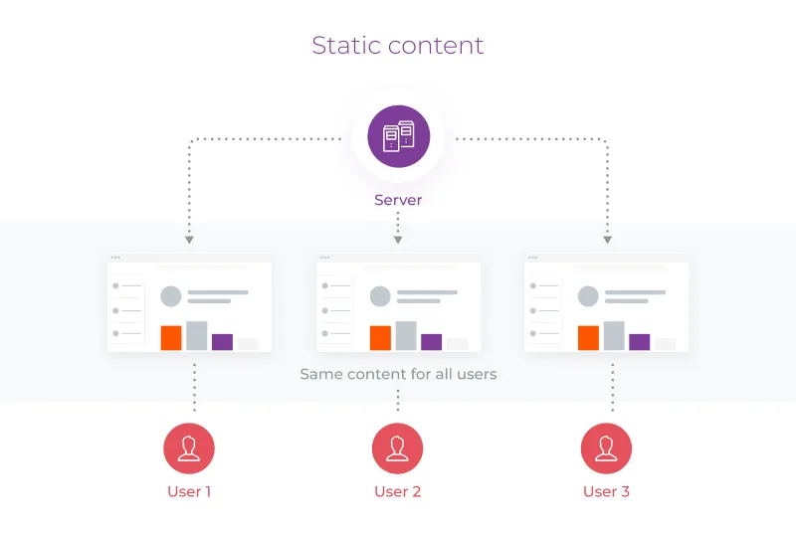
Static Content
Classic static content examples include pictures, videos, text files, HTML files, and other similar data. All of them were originally created by someone and posted online. These data can’t be changed.
Static content usage examples:
YouTube videos
Photos of products sold in online stores
Articles on news portals
Pages describing the services offered by a particular company
The main feature of static content is that it is easy to deliver and cache.

Slide 6
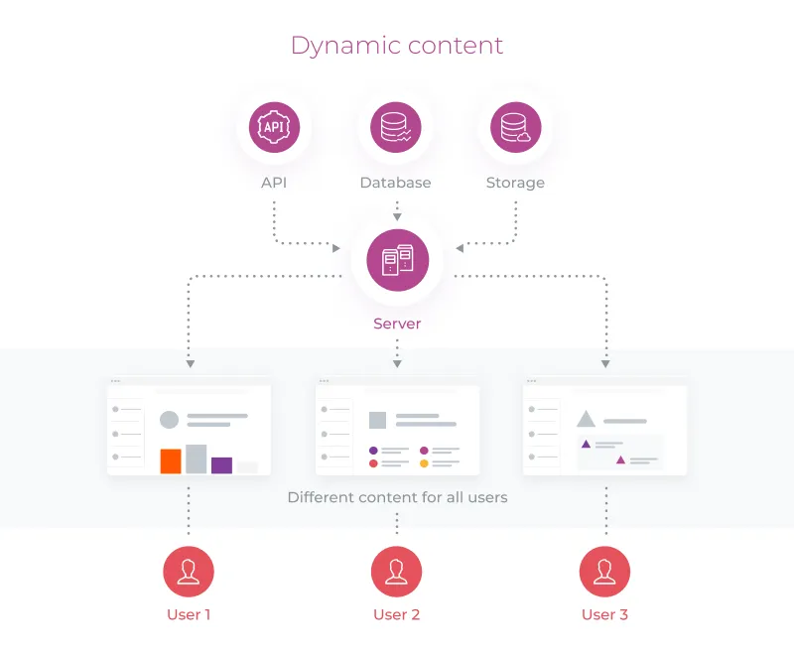
Dynamic Content
Classic dynamic content examples include web pages generated by PHP, Python, or JS code. Chat text messages also belong to dynamic content. Users exchange messages that are generated in the real-time mode.
Dynamic content usage examples:
The content published on social networks is mostly dynamic. Your Instagram feed differs a lot from that of your friend.
Advertising banners on websites. Usually, advertising offers seen by the users on websites or in social networks are different because they are based on the user’s unique online behavior.
Product selections, online store recommendations. If you open the homepage of one and the same store from your account and in the incognito mode, the recommendations will be different.
Since dynamic content is constantly changing, the process of delivering it to the users is more complex.

Slide 7
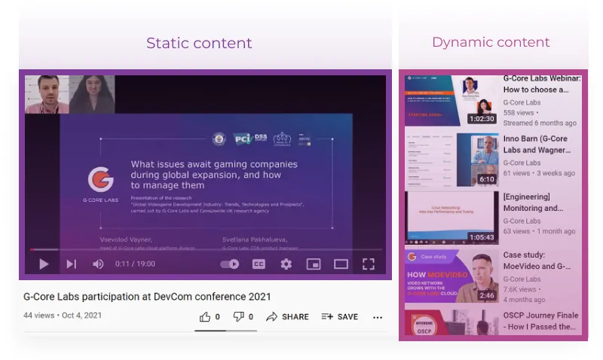
Static & Dynamic Content Example

Slide 8

Amazon CloudFront
Fast, global, and secure CDN service
Global network of edge locations and Regional edge caches
Self-service model
Cost-effective (Pay-as-you-go pricing)
Security at the edge
Highly programmable
Deeply integrated with AWS services
Amazon CloudFront
Notes:
Amazon CloudFront is a fast CDN service that securely delivers data, videos, applications, and application programming interfaces (APIs) to customers globally with low latency and high transfer speeds. It also provides a developer-friendly environment. Amazon CloudFront delivers files to users over a global network of edge locations and Regional edge caches. Amazon CloudFront is different from traditional content delivery solutions because it enables you to quickly obtain the benefits of high-performance content delivery without negotiated contracts, high prices, or minimum fees. Like other AWS services, Amazon CloudFront is a self-service offering with pay-as-you-go pricing.
Amazon CloudFront provides the following benefits:
Fast and global – Amazon CloudFront is massively scaled and globally distributed. To deliver content to end users with low latency, Amazon CloudFront uses a global network that consists of edge locations and regional caches.
Security at the edge – Amazon CloudFront provides both network-level and application-level protection. Your traffic and applications benefit through various built-in protections, such as AWS Shield Standard, at no additional cost. You can also use configurable features, such as AWS Certificate Manager (ACM), to create and manage custom Secure Sockets Layer (SSL) certificates at no extra cost.
Highly programmable – Amazon CloudFront features can be customized for specific application requirements. It integrates with Lambda@Edge so that you can run custom code across AWS locations worldwide, which enables you to move complex application logic closer to users to improve responsiveness. The CDN also supports integrations with other tools and automation interfaces for DevOps. It offers continuous integration and continuous delivery (CI/CD) environments.
Deeply integrated with AWS – Amazon CloudFront is integrated with AWS, with both physical locations that are directly connected to the AWS Global Infrastructure and other AWS services. You can use APIs or the AWS Management Console to programmatically configure all features in the CDN.
Cost-effective – Amazon CloudFront is cost-effective because it has no minimum commitments and charges you only for what you use. Compared to self-hosting, Amazon CloudFront avoids the expense and complexity of operating a network of cache servers in multiple sites across the internet. It eliminates the need to overprovision capacity to serve potential spikes in traffic. Amazon CloudFront also uses techniques like collapsing simultaneous viewer requests at an edge location for the same file into a single request to your origin server. The result is reduced load on your origin servers and reduced need to scale your origin infrastructure, which can result in further cost savings.

Slide 9
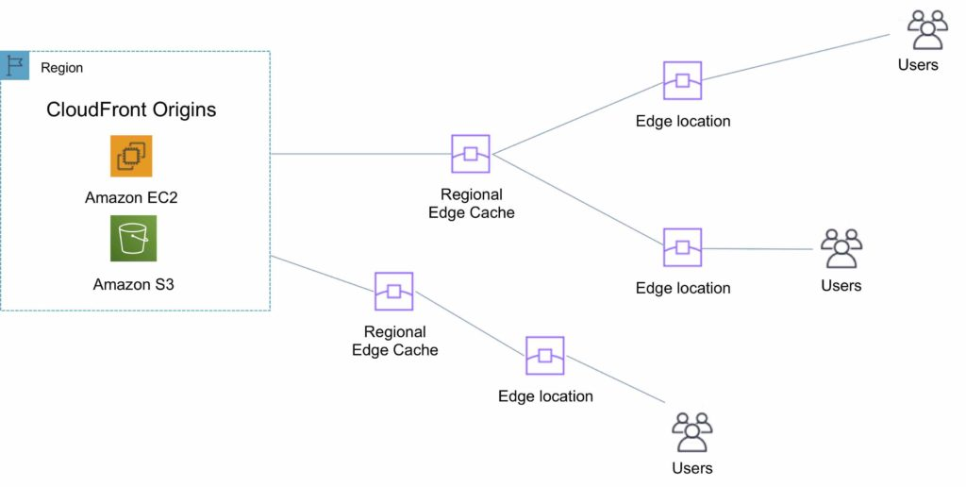
Amazon CloudFront infrastructure
An edge location is the location where content is cached (separate to AWS regions/AZs).
Requests are automatically routed to the nearest edge location.
Edge locations are not tied to Availability Zones or regions.
Regional Edge Caches are located between origin web servers and global edge locations and have a larger cache.
Regional Edge Caches have larger cache-width than any individual edge location, so your objects remain in cache longer at these locations.
Regional Edge caches aim to get content closer to users.
Proxy methods PUT/POST/PATCH/OPTIONS/DELETE go directly to the origin from the edge locations and do not proxy through Regional Edge caches.
Dynamic content goes straight to the origin and does not flow through Regional Edge caches.
Edge locations are not just read only, you can write to them too.

Slide 10
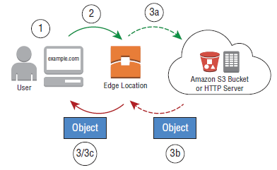
How the Amazon CloudFront Works ?
Users access your website or application and request one or more objects, such as an image file and an HTML file.
2. DNS routes the request to the Amazon CloudFront edge location that can best serve the user’s request, typically the nearest Amazon CloudFront edge location in terms of network latency.
3. In the edge location, Amazon CloudFront will check its cache for the requested files, returning them to the user if they are found in the cache.
If the files are not found in the cache, Amazon CloudFront will perform the following actions:
a. Amazon CloudFront will compare the request with your distribution configuration and forward the request for the files to the applicable origin server for the corresponding file type (for example, to your Amazon S3 bucket for image files and to your HTTP server for the HTML files).
b. The origin servers send the files back to the Amazon CloudFront edge location.
c. As soon as the first byte arrives from the origin, Amazon CloudFront begins to forward the files to the user. Amazon CloudFront also adds the files to the cache in the edge location for the next time someone requests those files.

Slide 11
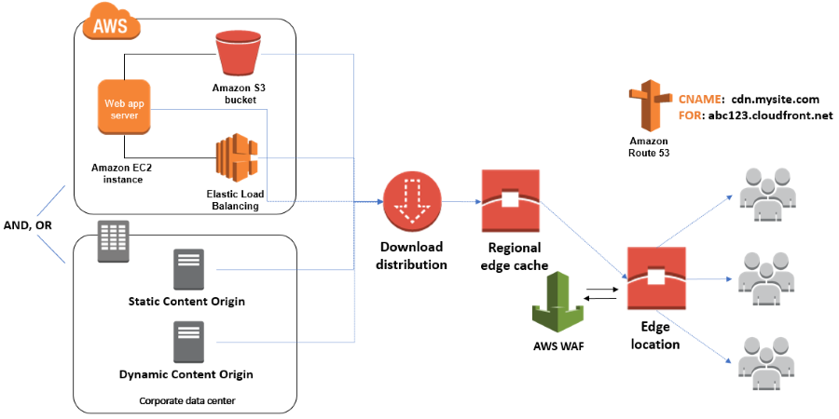
Amazon CloudFront infrastructure Components
Origin(s)
Distributions
Cache

Slide 12
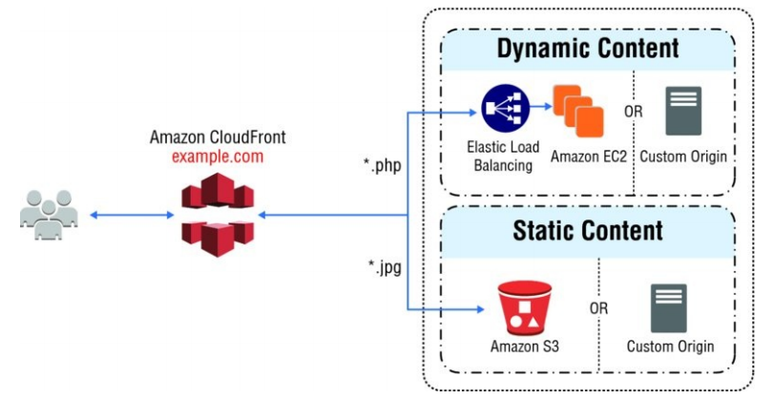
Amazon CloudFront : Origin
Origins : An origin is the origin of the files that the CDN will distribute.
Origin is A Bucket :
Origins can be either an S3 bucket, an EC2 instance, an Elastic Load Balancer, or Route 53 – can also be external (non-AWS).
When using Amazon S3 as an origin you place all your objects within the bucket.
You can use an existing bucket and the bucket is not modified in any way. By default all newly created buckets are private.
You can setup access control to your buckets using:
Bucket policies.
Access Control Lists.
You can make objects publicly available or
use CloudFront signed URLs.
Notes:
Origins : An origin is the origin of the files that the CDN will distribute.
Origins can be either an S3 bucket, an EC2 instance, an Elastic Load Balancer, or Route 53 – can also be external (non-AWS).
When using Amazon S3 as an origin you place all your objects within the bucket.
You can use an existing bucket and the bucket is not modified in any way.
By default all newly created buckets are private.
You can setup access control to your buckets using:
Bucket policies.
Access Control Lists.
You can make objects publicly available or use CloudFront signed URLs.
A custom origin server is a HTTP server which can be an EC2 instance or an on-premises/non-AWS based web server.
When using an on-premises or non-AWS based web server you must specify the DNS name, ports, and protocols that you want CloudFront to use when fetching objects from your origin.
Most CloudFront features are supported for custom origins except RTMP distributions (must be an S3 bucket).

Slide 13
Amazon CloudFront : Origin
Origin is A EC2:
Use an AMI that automatically installs the software for a web server.
Use ELB to handle traffic across multiple EC2 instances.
Specify the URL of your load balancer as the domain name of the origin server.
Origin is S3 static website:
Enter the S3 static website hosting endpoint for your bucket in the configuration.
Example: http://<bucketname>.s3-website-<region>.amazonaws.com.
Objects are cached for 24 hours by default.
The expiration time is controlled through the TTL.
The minimum expiration time is 0.
Static websites on Amazon S3 are considered custom origins.
CloudFront keeps persistent connections open with origin servers.
Files can also be uploaded to CloudFront.
Source: digitalcloud.training
Notes:
When using EC2 for custom origins Amazon recommend:
Use an AMI that automatically installs the software for a web server.
Use ELB to handle traffic across multiple EC2 instances.
Specify the URL of your load balancer as the domain name of the origin server.
S3 static website:
Enter the S3 static website hosting endpoint for your bucket in the configuration.
Example: http://<bucketname>.s3-website-<region>.amazonaws.com.
Objects are cached for 24 hours by default.
The expiration time is controlled through the TTL.
The minimum expiration time is 0.
Static websites on Amazon S3 are considered custom origins.
AWS origins are Amazon S3 buckets (not a static website).
CloudFront keeps persistent connections open with origin servers.
Files can also be uploaded to CloudFront.
High availability with Origin Failover:
Can set up CloudFront with origin failover for scenarios that require high availability.
Uses an origin group in which you designate a primary origin for CloudFront plus a second origin that CloudFront automatically switches to when the primary origin returns specific HTTP status code failure responses.

Slide 14
Amazon CloudFront : Distribution
Distribution: To distribute content with CloudFront you need to create a distribution.
The distribution includes the configuration of the CDN including:
Content origins.
Access (public or restricted).
Security (HTTP or HTTPS).
Cookie or query-string forwarding.
Geo-restrictions.
Access logs (record viewer activity).
There are two types of distribution.
Web Distribution:
Static and dynamic content including .html, .css, .php, and graphics files.
Distributes files over HTTP and HTTPS.
Add, update, or delete objects, and submit data from web forms.
Use live streaming to stream an event in real time.
RTMP: ( Real Time Messaging Protocol)
Distribute streaming media files using Adobe Flash Media Server’s RTMP protocol.
Allows an end user to begin playing a media file before the file has finished downloading from a CloudFront edge location.
Files must be stored in an S3 bucket.
Notes:
Distributions: To distribute content with CloudFront you need to create a distribution.
The distribution includes the configuration of the CDN including:
Content origins.
Access (public or restricted).
Security (HTTP or HTTPS).
Cookie or query-string forwarding.
Geo-restrictions.
Access logs (record viewer activity).
There are two types of distribution.
Web Distribution:
Static and dynamic content including .html, .css, .php, and graphics files.
Distributes files over HTTP and HTTPS.
Add, update, or delete objects, and submit data from web forms.
Use live streaming to stream an event in real time.
RTMP:Real-Time Messaging Protocol
Distribute streaming media files using Adobe Flash Media Server’s RTMP protocol.
Allows an end user to begin playing a media file before the file has finished downloading from a CloudFront edge location.
Files must be stored in an S3 bucket.
To use CloudFront live streaming, create a web distribution.
For serving both the media player and media files you need two types of distributions:
A web distribution for the media player.
An RTMP distribution for the media files.
S3 buckets can be configured to create access logs and cookie logs which log all requests made to the S3 bucket.
Amazon Athena can be used to analyze access logs.
CloudFront is integrated with CloudTrail.
CloudTrail saves logs to the S3 bucket you specify.
CloudTrail captures information about all requests whether they were made using the CloudFront console, the CloudFront API, the AWS SDKs, the CloudFront CLI, or another service.
CloudTrail can be used to determine which requests were made, the source IP address, who made the request etc.
To view CloudFront requests in CloudTrail logs you must update an existing trail to include global services.
To delete a distribution it must first be disabled (can take up to 15 minutes).

Slide 15
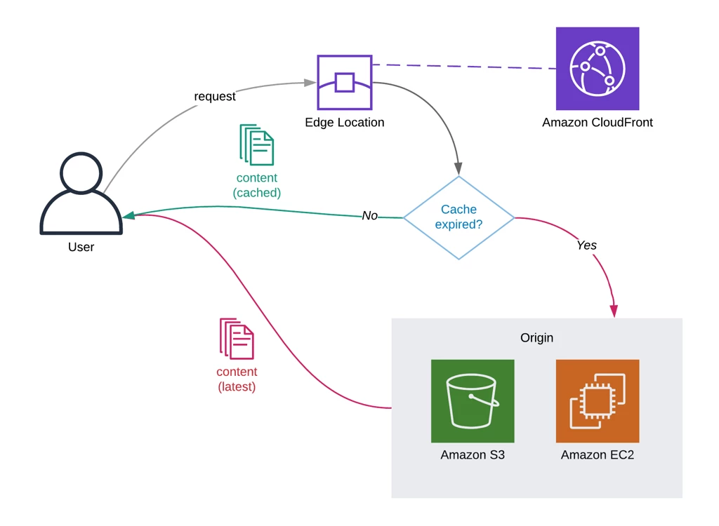
Amazon CloudFront : Cache
Once requested and served from an edge location, objects stay in the cache until they expire or are evicted to make room for more frequently requested content. By default, objects expire from the cache after 24 hours.
After an object expires, the next request results in Amazon CloudFront forwarding the request to the origin to verify that the object is unchanged or to fetch a new version if it has changed.
Optionally, you can control how long objects stay in an Amazon CloudFront cache before expiring. To do this, you can choose to use Cache-Control headers set by your origin server, or you can set the minimum, maximum, and default Time to Live (TTL) for objects in your Amazon CloudFront distribution.
You can also remove copies of an object from all Amazon CloudFront edge locations at any time by calling the invalidation Application Programming Interface (API) or through the Amazon CloudFront console. This feature removes the object from every Amazon CloudFront edge location regardless of the expiration period you set for that object on your origin server.
Instead of invalidating objects manually or programmatically, it is a best practice to use a version identifier as part of the object (file) path name. For example, note the following:
Old file: assets/v1/css/narrow.css
New file: assets/v2/css/narrow.css
Notes:
When using versioning, users will see the latest content through Amazon CloudFront when you update your site without using invalidation. Old versions will expire from the cache automatically. That said, depending on other settings, you may need to invalidate the base page that includes references to the versioned objects.

Slide 16
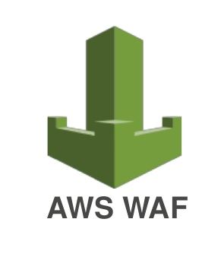
Amazon CloudFront infrastructure Security
AWS WAF
AWS WAF is a web application firewall that lets you monitor HTTP and HTTPS requests that are forwarded to CloudFront and lets you control access to your content.
With AWS WAF you can shield access to content based on conditions in a web access control list (web ACL) such as:
Origin IP address.
Values in query strings.
CloudFront responds to requests with the requested content or an HTTP 403 status code (forbidden).
CloudFront can also be configured to deliver a custom error page.
Need to associate the relevant distribution with the web ACL

Slide 17
Amazon CloudFront pricing
Data transfer out
Charged for the volume of data transferred out from Amazon CloudFront edge location to the internet or to your origin.
HTTP(S) requests
Charged for number of HTTP(S) requests.
Invalidation requests
No additional charge for the first 1,000 paths that are requested for invalidation each month. Thereafter, $0.005 per path that is requested for invalidation.
Dedicated IP custom SSL ,$600 per month for each custom SSL certificate that is associated with one or more CloudFront distributions that use the Dedicated IP version of custom SSL certificate support.
Notes:
Amazon CloudFront charges are based on actual usage of the service in four areas:
Data transfer out – You are charged for the volume of data that is transferred out from Amazon CloudFront edge locations, measured in GB, to the internet or to your origin (both AWS origins and other origin servers). Data transfer usage is totaled separately for specific geographic regions, and then cost is calculated based on pricing tiers for each area. If you use other AWS services as the origins of your files, you are charged separately for your use of those services, including storage and compute hours.
HTTP(S) requests – You are charged for the number of HTTP(S) requests that are made to Amazon CloudFront for your content.
Invalidation requests – You are charged per path in your invalidation request. A path that is listed in your invalidation request represents the URL (or multiple URLs if the path contains a wildcard character) of the object that you want to invalidate from CloudFront cache. You can request up to 1,000 paths each month from Amazon CloudFront at no additional charge. Beyond the first 1,000 paths, you are charged per path that is listed in your invalidation requests.
Dedicated IP custom Secure Sockets Layer (SSL) – You pay $600 per month for each custom SSL certificate that is associated with one or more CloudFront distributions that use the Dedicated IP version of custom SSL certificate support. This monthly fee is prorated by the hour. For example, if your custom SSL certificate was associated with at least one CloudFront distribution for just 24 hours (that is, 1 day) in the month of June, your total charge for using the custom SSL certificate feature in June is (1 day / 30 days) * $600 = $20.

Slide 18
Module Summary
A CDN is a globally distributed system of caching servers that accelerates delivery of content.
Amazon CloudFront is a fast CDN service that securely delivers data, videos, applications, and APIs over a global infrastructure with low latency and high transfer speeds.
Amazon CloudFront offers many benefits.
Notes:
Some key takeaways from this section of the module include:
A CDN is a globally distributed system of caching servers that accelerates delivery of content.
Amazon CloudFront is a fast CDN service that securely delivers data, videos, applications, and APIs over a global infrastructure with low latency and high transfer speeds.
Amazon CloudFront offers many benefits, including:
Fast and global
Security at the edge
Highly programmable
Deeply integrated with AWS
Cost-effective

